Slide 1
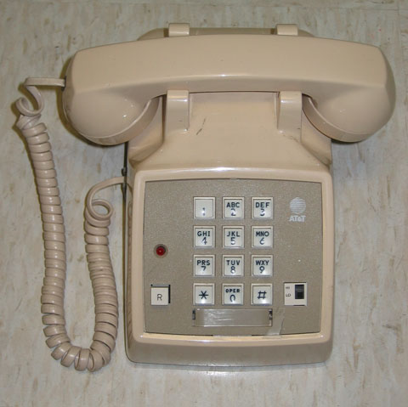
Touch-Tone Recognition
EE301 Final Project
April 26, 2010
MHP 101
  Norman Chung Alexander Nobles
  Rocky Mark Juan Bryce Toth
Hieu Nguyen
A 1970's era AT&T "Touch-Tone" telephone
Notes:
Alex will introduce the team members

Slide 2
Agenda
Introduction and History
Applications and Future
Project Description
Relation to EE301
Individual Contributions
Technical Results and Problems Encountered
Demonstration
Conclusion
Bibliography
Questions?

Slide 3
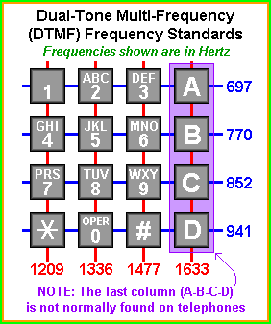
Introduction to DTMF
4 x 4 grid, one frequency for each row and column
Unique two-tone signal for each digit
Switching station decodes signal with 8 bandpass filters

Slide 4
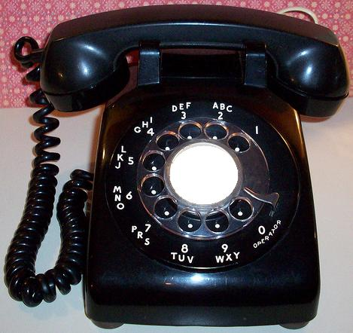
History of DTMF
  Pre-'60s: Manual switching, pulse dialing
      Pulse dialing payphone abuse
  DTMF frequencies chosen to avoid harmonics, modulation problems
Notes:
Alex

Slide 5
Applications and Future of DTMF
Current Application: Telephone Technology & Communication
Improvements: Better filtering to deal with noise
Future: Battle with digital technology
  Requires a more widespread application and improvements in design
Notes:
Bryce

Slide 6
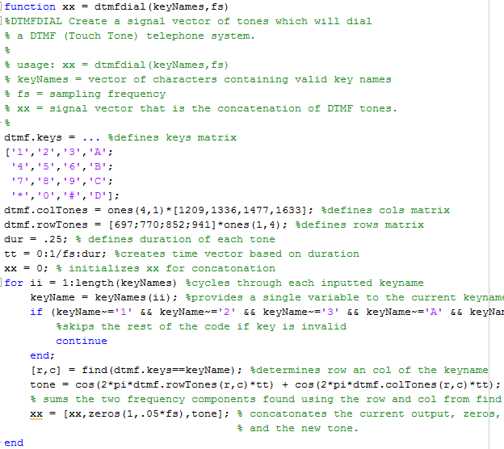
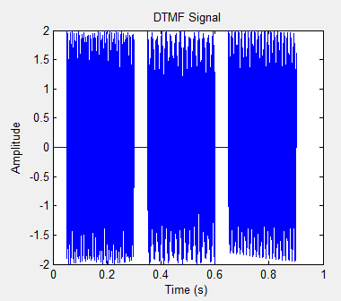
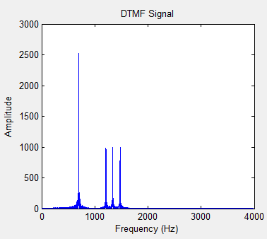
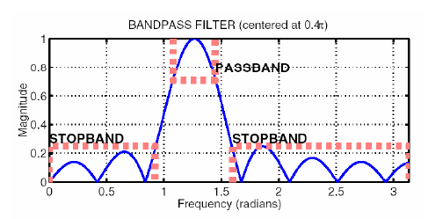

Project Description
  5 main parts:
    DTMF generation
    Parse DTMF signal
    Filters
    Scoring function
    Decode/return string
Notes:
We implemented our touch-tone recognition project using Matlab, which consisted of 5 main parts. First, we generate our own touch tones by summing the corresponding frequencies together. Next, if the DTMF signal consisted of multiple touch tones, we parse the signal to obtain a set of individual tone segments. Then we put each tone through a series of bandpass filters and computed the impulse response to isolate individual sinusoids. After filtering, we have a scoring function to check if the input signal frequency matches frequencies within the filter passbands. And finally, we decode and return a text string, which corresponds to the touch tones represented by the DTMF signal.
We’ve also mixed in more levels of sophistication in Matlab, such as adding noise to the signal, filtering that noise, and processing it in real-time. Just exploring some other applications

Slide 7
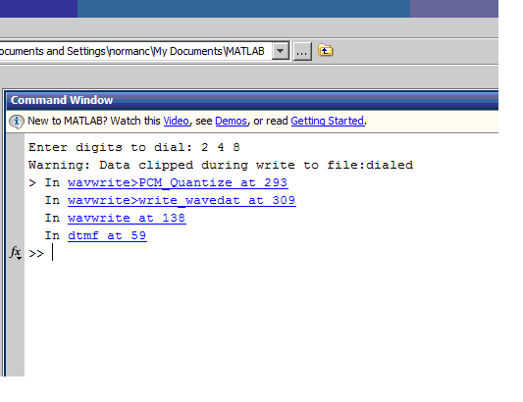
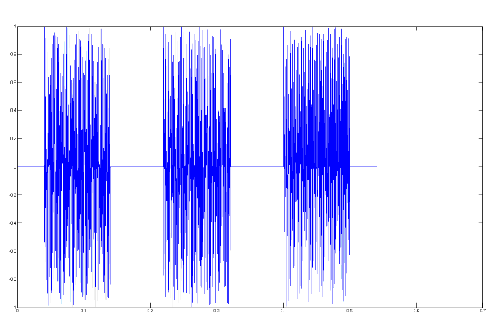
Relation to EE301
Input signal “2 4 8” represented as impulse response in time domain
Notes:
Norman

Slide 8
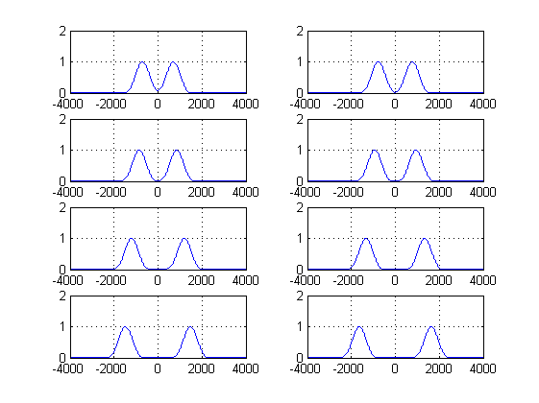
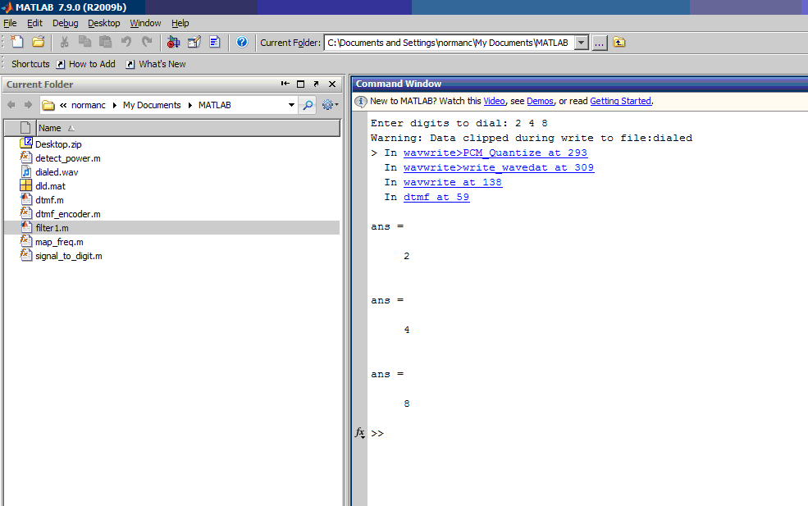
Relation to EE301
Applying filter to detect the input signal by eight bandpass filters
Notes:
Norman

Slide 9
Individual Contributions

Slide 10
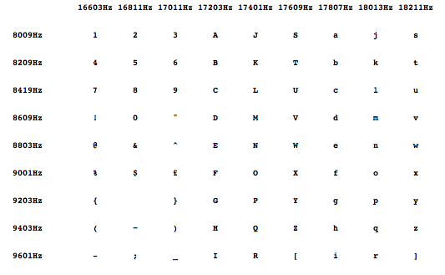
What Bryce worked on…
DTMF Dial Function: function that creates the tone from a combination of 2 tones corresponding to the input element
Notes:
Bryce

Slide 11
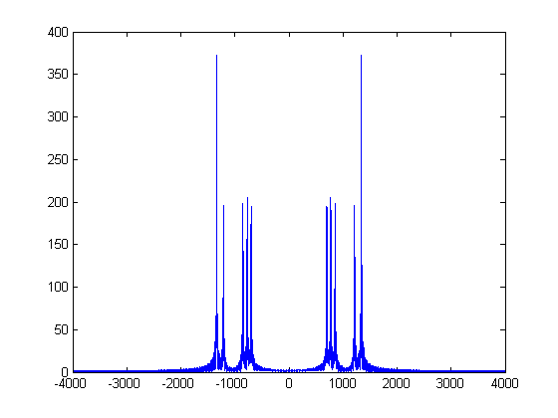
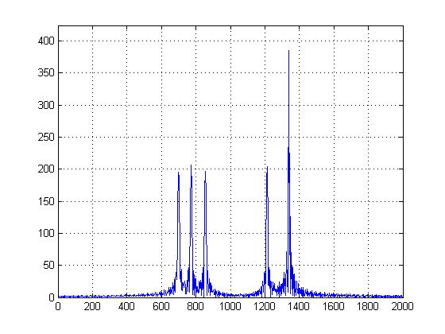
What Norman worked on…
Input signal “2 4 8” represented as
frequency response in frequency domain
Notes:
Norman

Slide 12
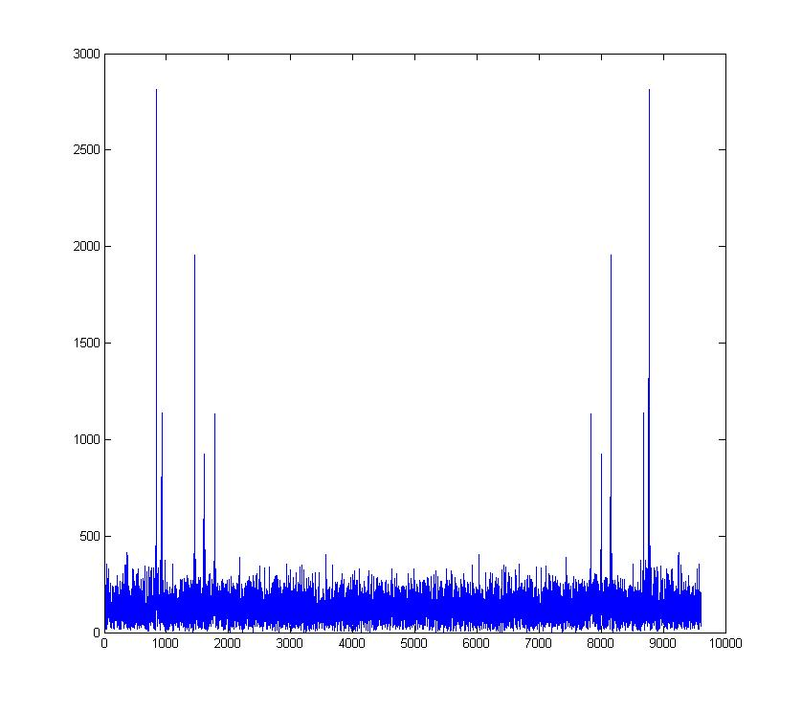
What Rocky worked on…
Matlab Coding
  dtmfcut.m
Adding Noise
  White Gaussian Noise
  FFT
Noise Reduction
  FDATool
  wdencmp
Notes:
Rocky

Slide 13
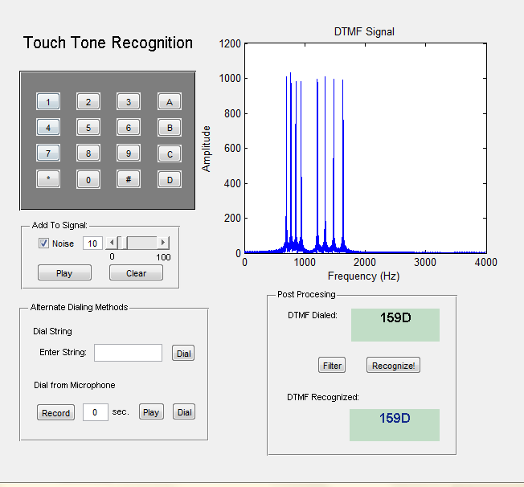
What Hieu worked on…
Creating the GUI
  Made project easier to integrate together, test/debug, and demonstrate
  Writing the code…
dtmfscore.m
  Making sense of the DTMF signal
Notes:
My main responsibility for this project was creating/programming the graphical user interface, which you will see toward the end of this presentation. The GUI made the project easier to integrate our Matlab functions together, and easier to test/debug our code; the GUI allowed us to click and choose, rather than repeatedly entering commands via command line. I’ve never created a GUI in Matlab before, so it was challenging to learn it on my own. Luckily, Matlab has a wide user-base, so there are several tutorials and examples available on the Internet.
I was also in charge of the “dtmfscore” function. Essentially, it convolves the impulse response of a bandpass filter and a touch tone, and if its magnitude is greater than a certain threshold value, it passes through, otherwise it doesn’t. However, this method had to change when introducing noise to the signal.

Slide 14
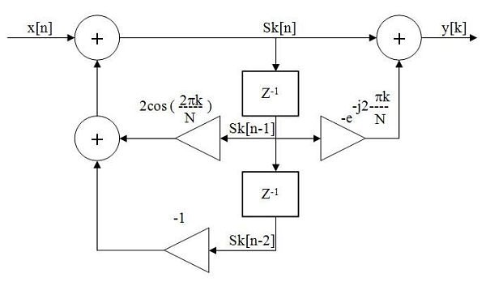
What Alex worked on…
Fourier series Matlab function
dtmfdesign.m
Goertzel Algorithm
Notes:
Alex

Slide 15
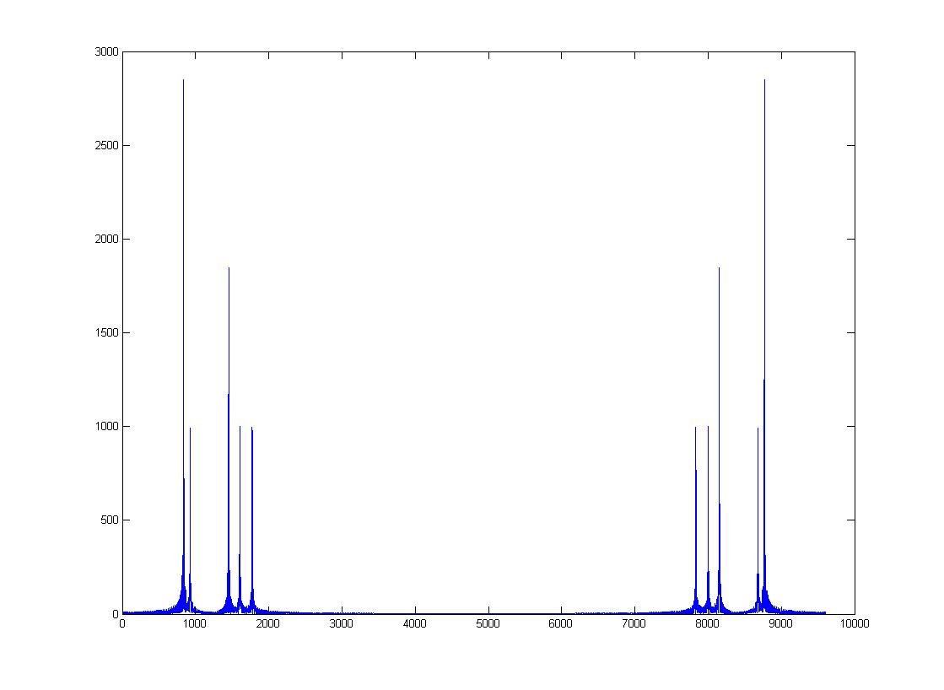
Technical Results
Without Noise
With Noise
Notes:
Signal to Noise Ratio (SNR)?
*Our struggles with Matlab (maybe?)
*Images of our tone with, and without noise
*Talk about our problems with trying to record

Slide 16

Problems
  Inexperience with Matlab
  Extending DTMF to entire alpha-numeric alphabet
  Analyze Raw Signal with Audio Device
  White Noise Filtering

Slide 17
Project Demonstration
Notes:
DTMF from keypad, Time-domain Graphs, Recognize, Add noise, Filter, Recognize, Freq-domain Graphs
Mention DTMF from string entry
Real-time DTMF recognition from recording

Slide 18
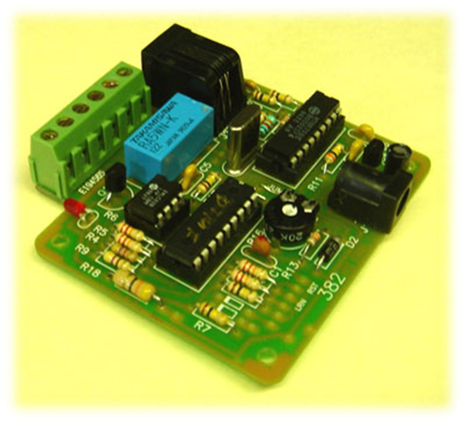
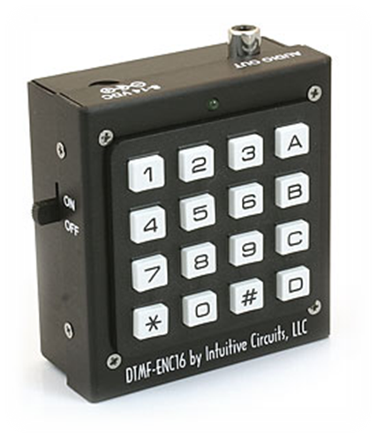
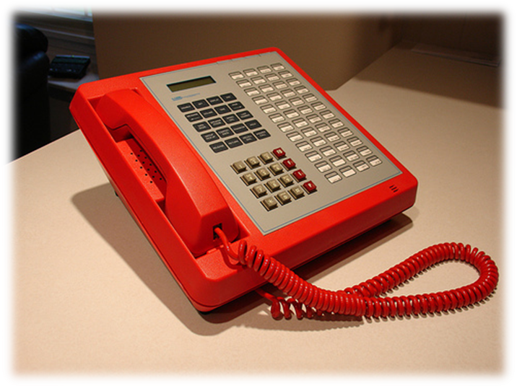
Conclusion
Notes:
This project has improved our understanding of the complex processes that go on inside the touch-tone creation and decoding process. Implementing touch-tone recognition in Matlab has allowed us to explore signal processing, fourier transforms, the distorting effects of noise, and using filters to recover a signal. Our project has applications in various devices such as the ones shown here on this slide, which include a DTMF generator, a DTMF decoder implemented in hardware, and an Autovon (automated voice network) phone system developed by the military with AT&T to survive nuclear attacks.
Interesting, but like Bryce said earlier, DTMF will soon be outdated by digital technology.

Slide 19
Bibliography
http://members.fortunecity.com/stefaldo/project/project_dtmf.html
http://en.wikipedia.org/wiki/Dual-tone_multi-frequency_signaling
http://www.lumenvox.com/resources/whitePapers/dtmfSpeech.aspx
http://www.mathworks.com/matlabcentral/
http://www.shawnlankton.com/2003/08/dtmf-generator/

Slide 20
Questions?

